Slide 1
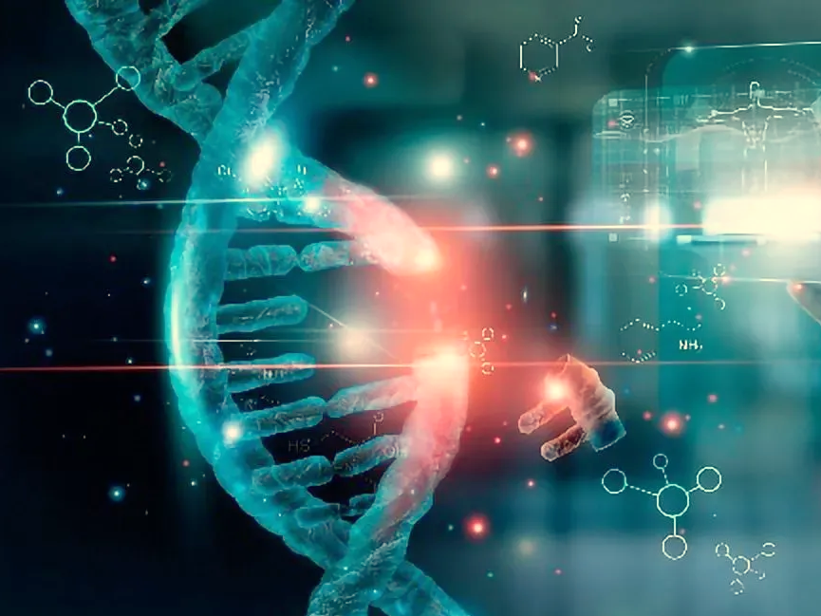
Nucleic Acid and Protein Technology in Medical Diagnosis
Patipark Kueanjinda, Ph.D.
2005708 Principles in Molecular Biology
Semester I, 2023

Slide 2
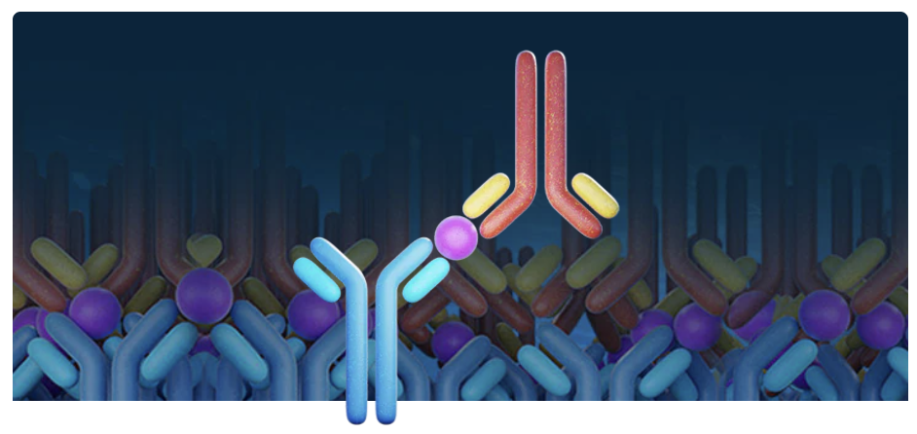
Immunoassays

Slide 3
Immunoassay
Base on high-affinity binding of antibodies with specific antigens.
Wide range of applications
chemical contaminant analysis.
identification of bacteria and viruses.
detection of proteins in food and agricultural products.

Slide 4
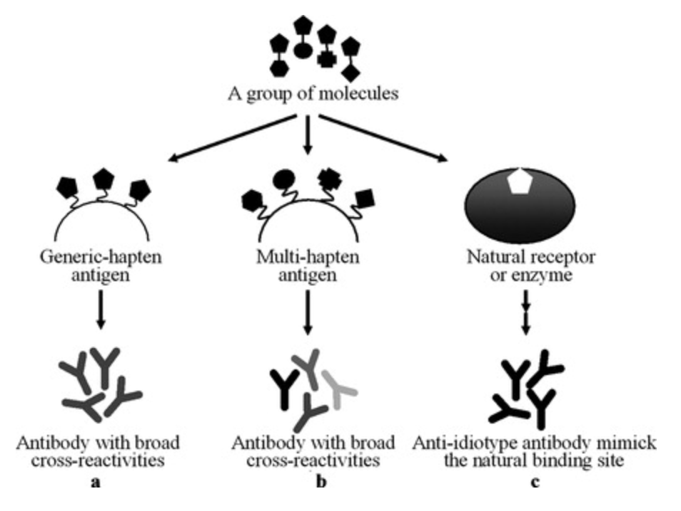
Immunoassay contents
Antigens
Usually > 5000 Da in size to be captured by antibodies.
Hapten is a small molecule (<5000 Da; normally toxins or antibiotics), must be linked to a carrier protein (OVA or BSA).

Slide 5
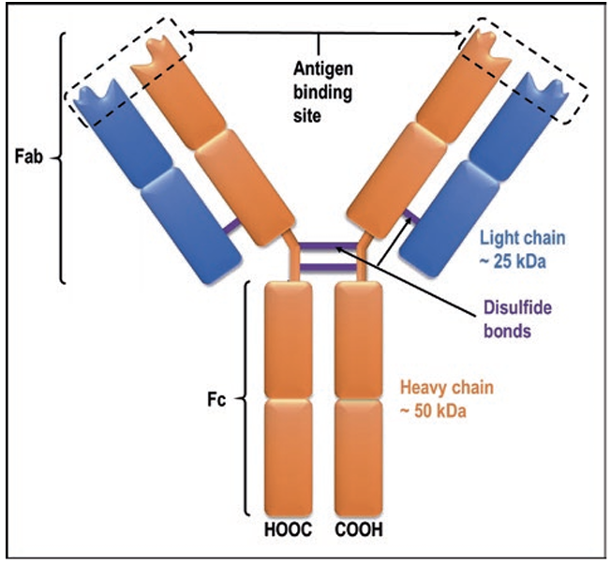
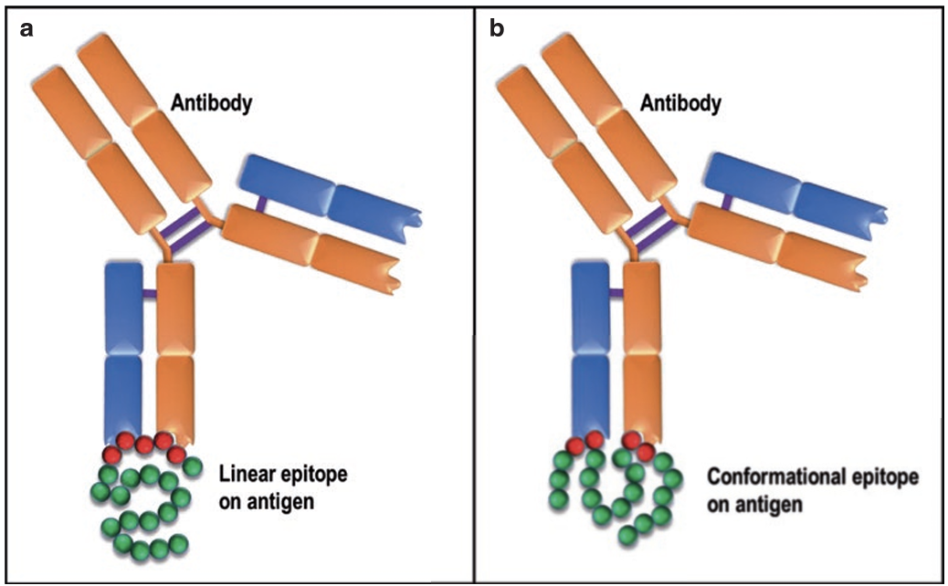
Immunoassay contents
Antibodies
Five major classes—IgA, IgE, IgG, IgM, IgD.
Antigen binding sites are located at CD3 regions on variable regions of heavy and light chains.
Binding affinity determines specificity.
Heat or pH may change protein conformation, reducing binding affinity
Monoclonal or polyclonal antibodies.

Slide 6
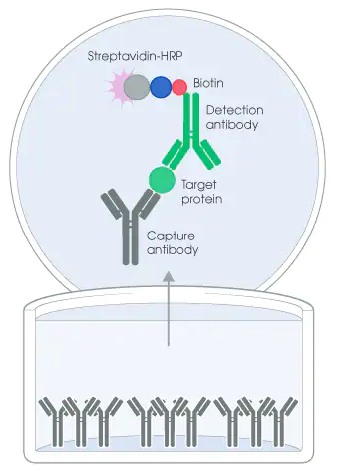
Immunoassay concept
Use antibody as the capture molecule to search the target antigen.
Use antigen as the capture molecule to trap the antibody.
Separate free antigen from bound antigen.
Proteins can be immobilized via hydrophobic interaction with membranes made from nitrocellulose or polyvinylidene difluoride (PVDF) or from polystyrene or polyvinyl plastic surface.
Antibody-bound antigens must be quantifiable at low concentrations for maximum sensitivity.

Slide 7
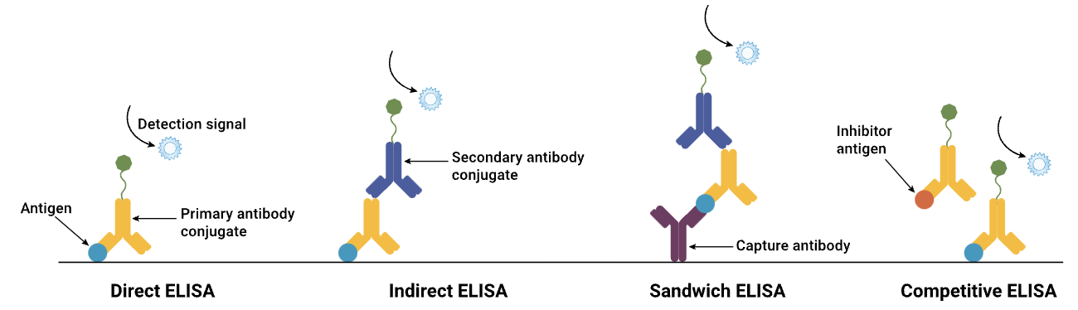
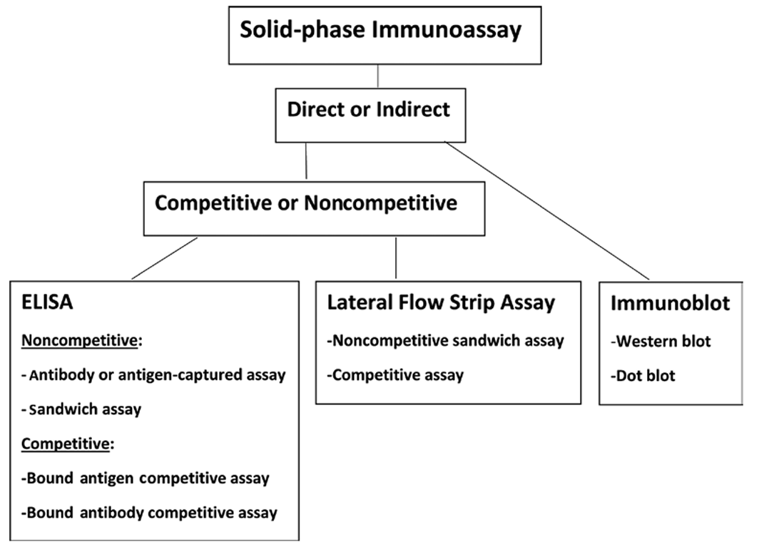
Immunoassay types

Slide 8
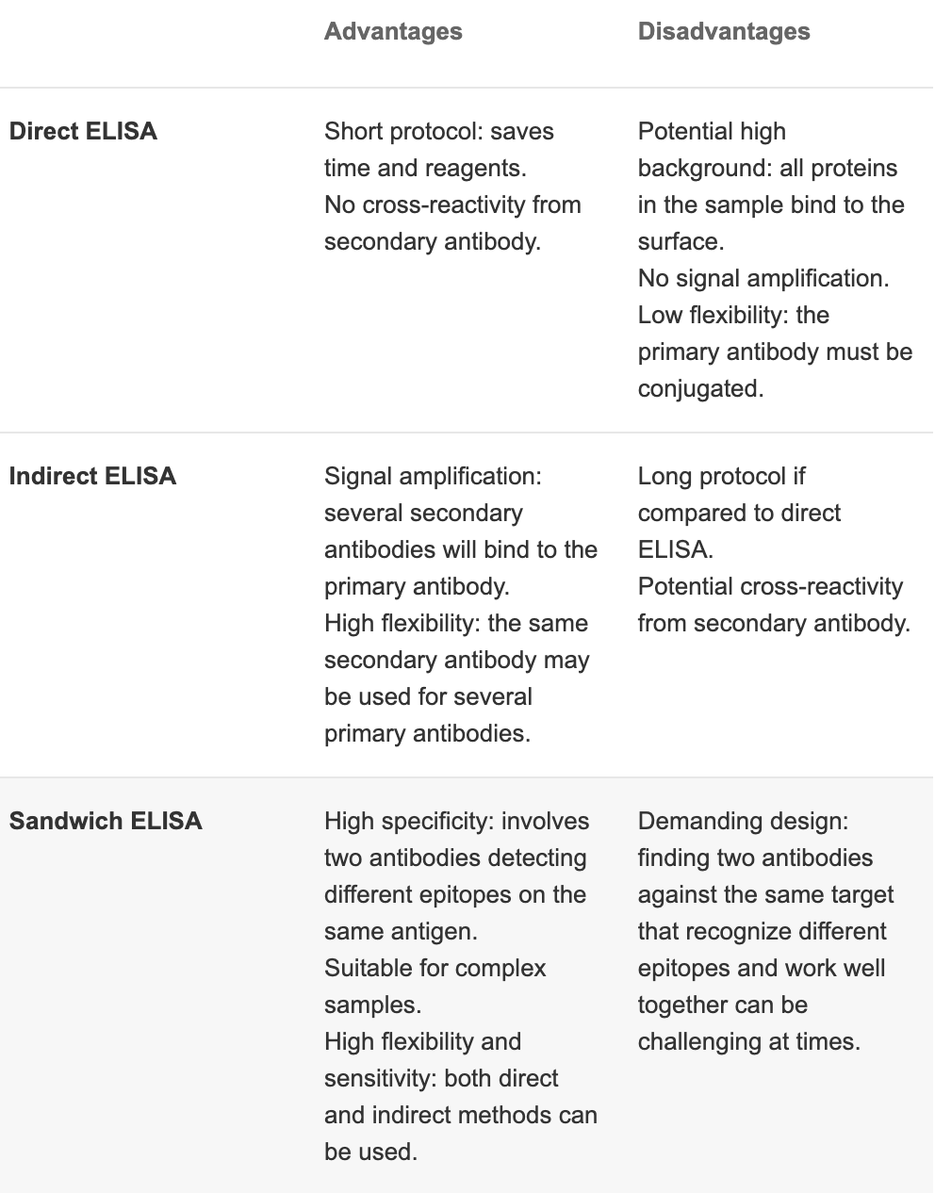
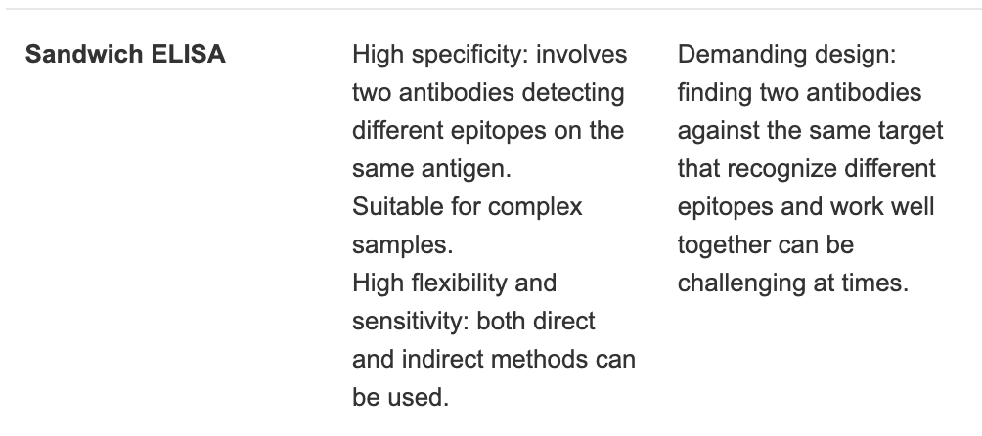
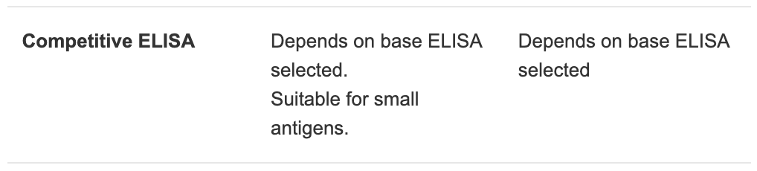
Immunoassay pros/cons

Slide 9
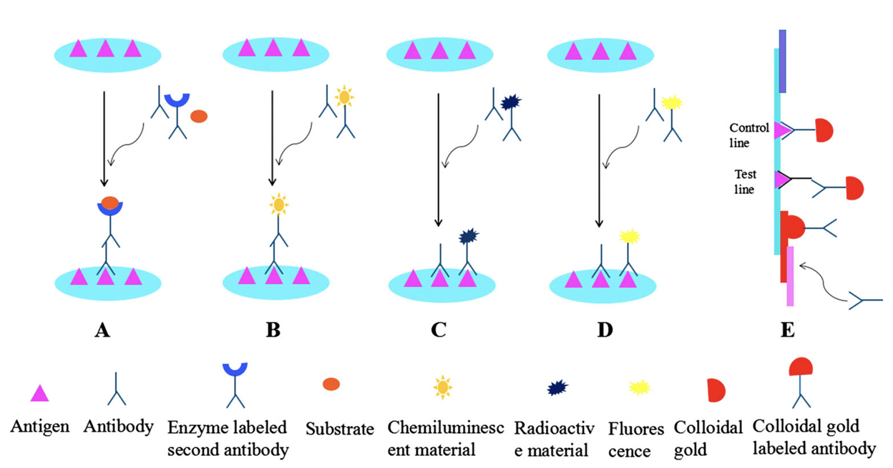
Immunoassay signal amplification
Increase signal detection of target antigens using different labeling compounds.
Radioisotopes, fluorochromes, enzymes, biotin, gold nanoparticles.

Slide 10
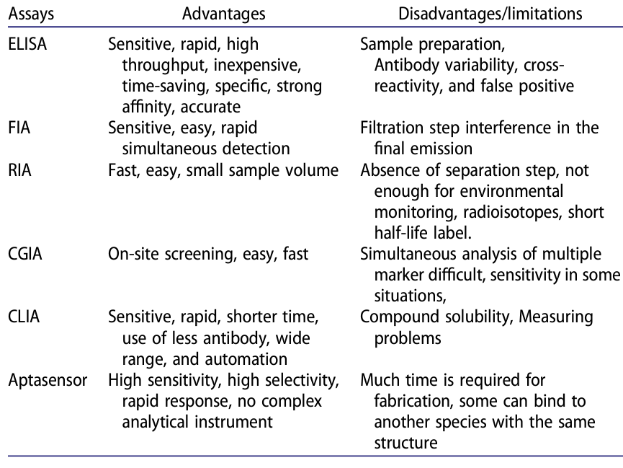
Immoassay pros vs. cons

Slide 11
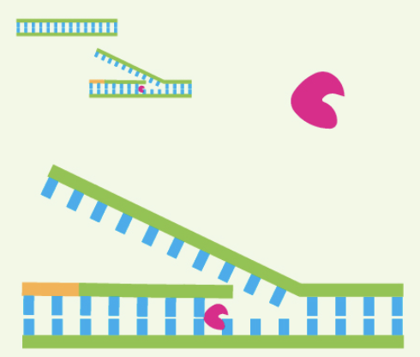
LAMP

Slide 12
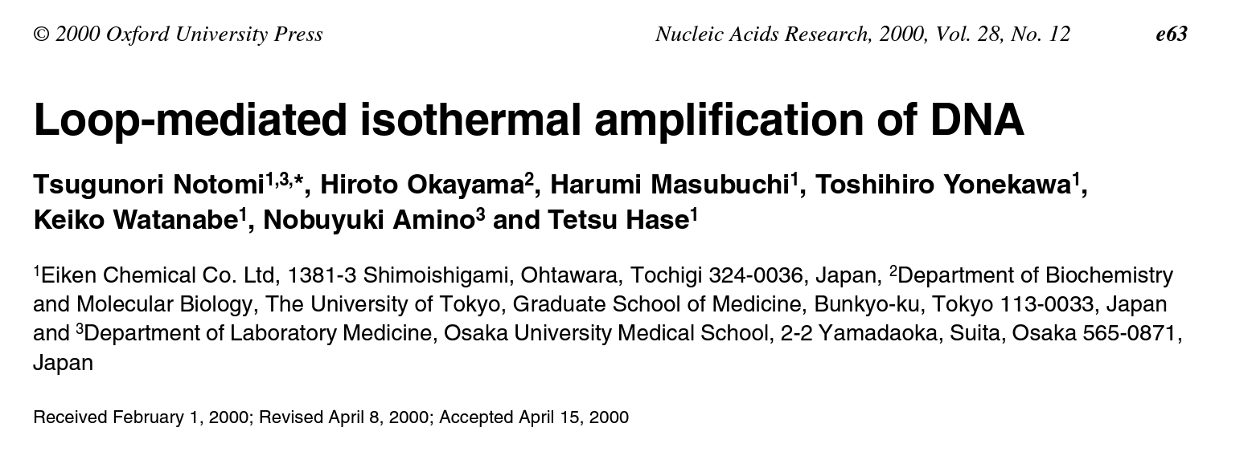
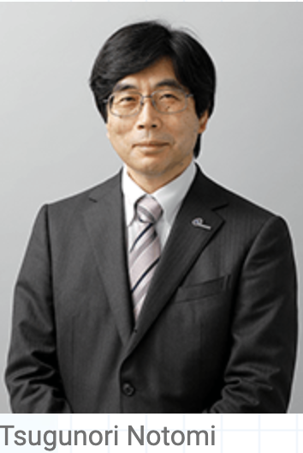

LAMP
Loop-mediated isothermal amplification

Slide 13
LAMP
Increase 2-3 copies of DNA to 10⁹ in an hour
Bacillus stearothermophilus (Bst) DNA/RNA polymerase
Mixture of Bst DNA and RNA polymerase
Bst DNA polymerase
no 5’-3’ exonuclease activity
strand-displacement ability
Bst RNA polymerase
no 5’-3’ and 3’-5’ exonuclease activity
reverse transcription ability
Thermal stability

Slide 14
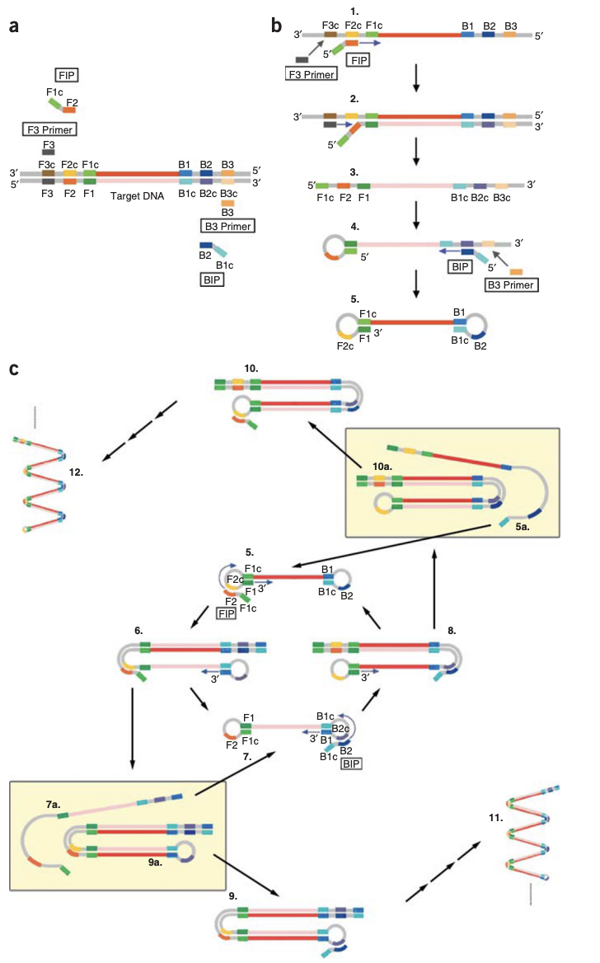
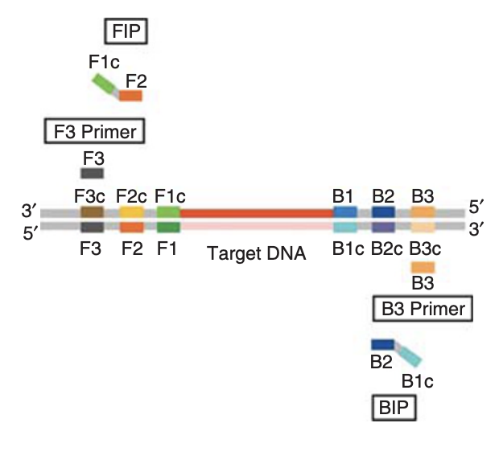
LAMP workflow
Inner primers
-Forward inner primer (FIP)—F1c and F2
-Backward inner primer (BIP)–B1c and B2
Outer primers
-F3
-B3

Slide 15
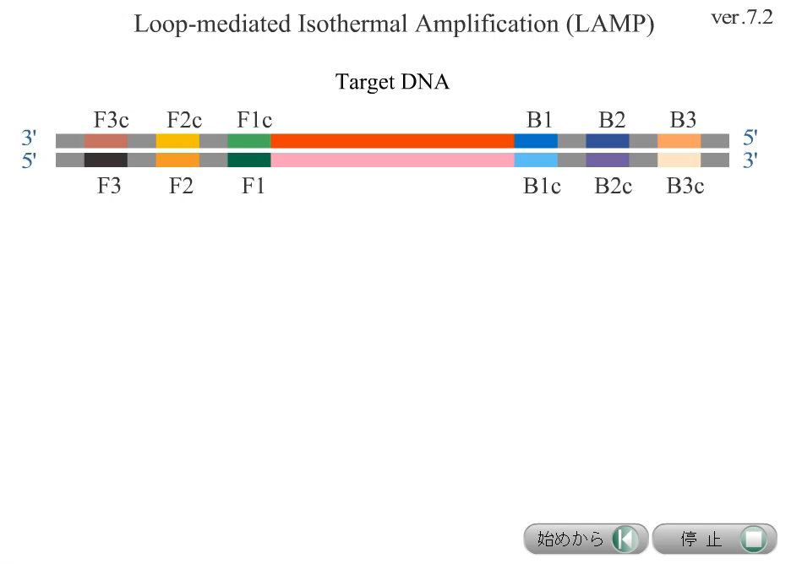

Slide 16
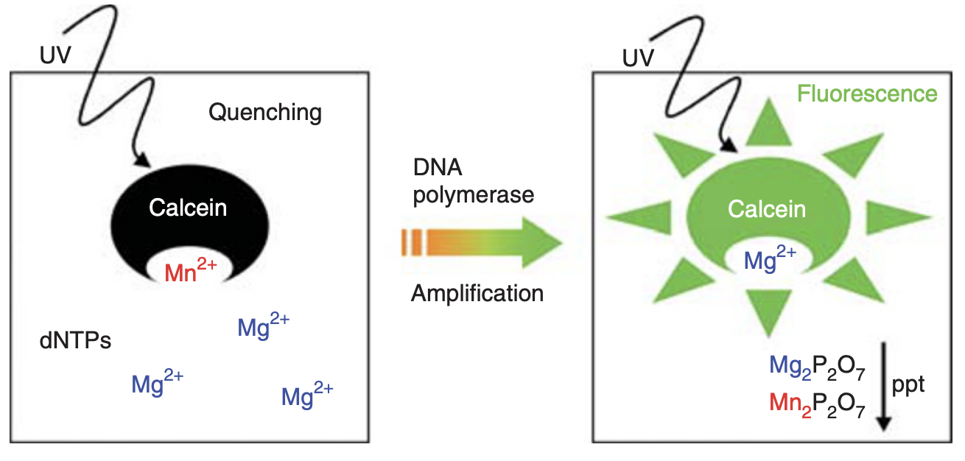
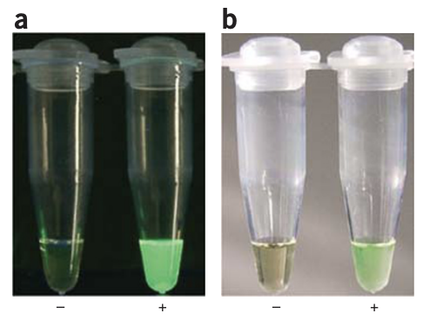
LAMP detection
During strand extension using dNTPs, pyrophosphate ions (PPi) are generated and Mg₂⁺ are decreased.
Use calcein indicator to monitor LAMP activity:
Calcein + Mn₂+ → no emission
Mn₂⁺ was replaced with Mg₂⁺ in calcine → fluorescent emission when exposed to UV

Slide 17
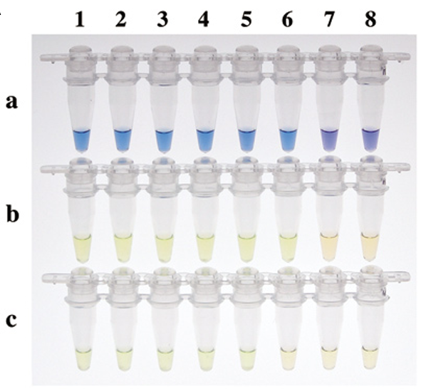
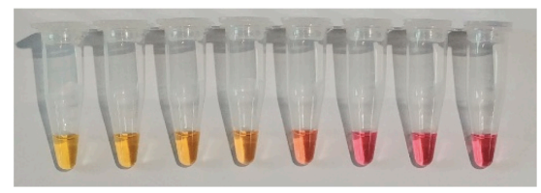
LAMP detection
Colorimetric indicator
Hydroxyl nappthol blue (HNB) develops a purple color in the presence of Mg₂⁺.
As Mg₂⁺ concentration decrease, HNB changes to blue.
pH indicator
Hydrogen ions are also released during dNTP incorporation.
Phenol red changes color as a result of proton generation.

Slide 18
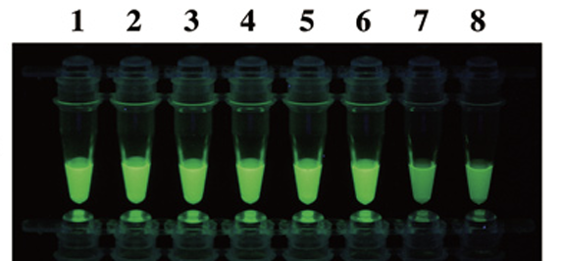
LAMP detection
Fluorescent indicator
DNA chelating dye: SYBR Green, ethidium bromide monoazide.

Slide 19
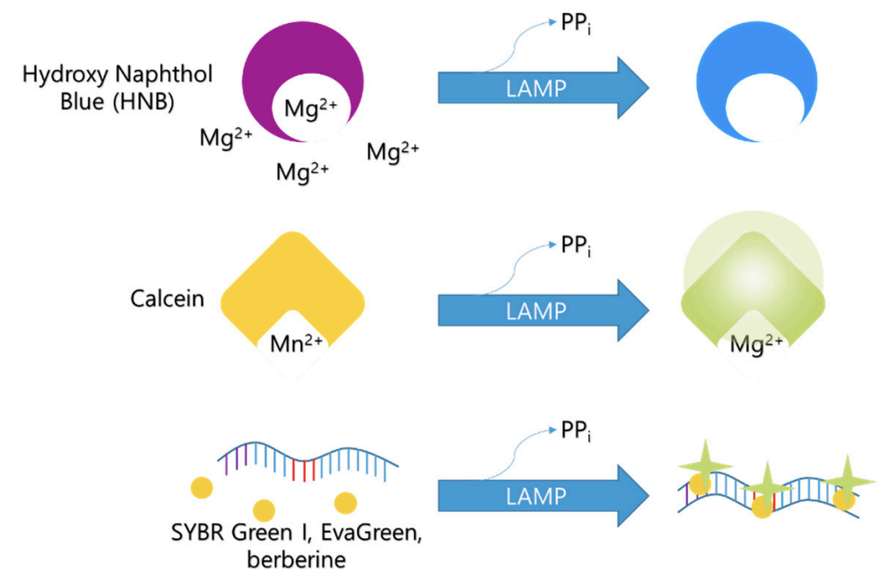
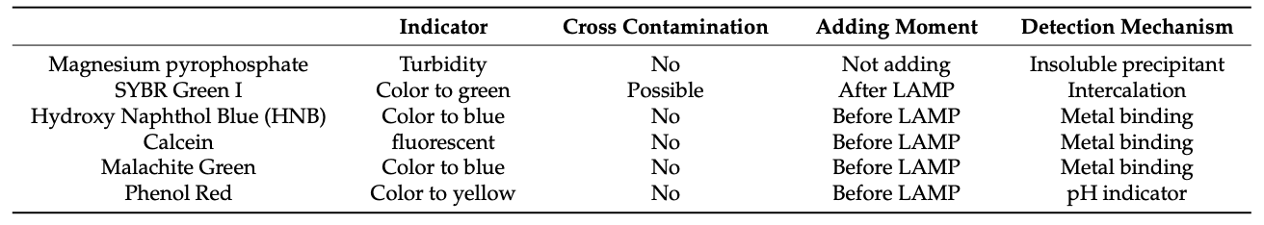
LAMP summary

Slide 20
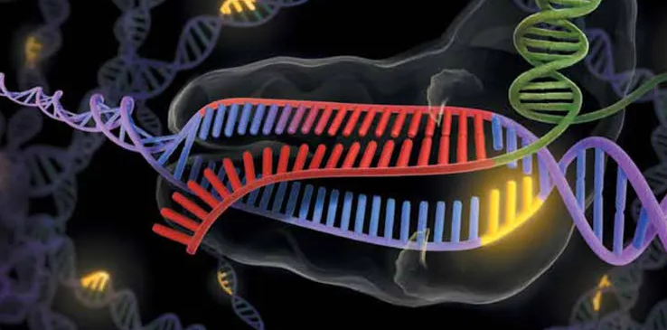
CRISPR-Cas

Slide 21

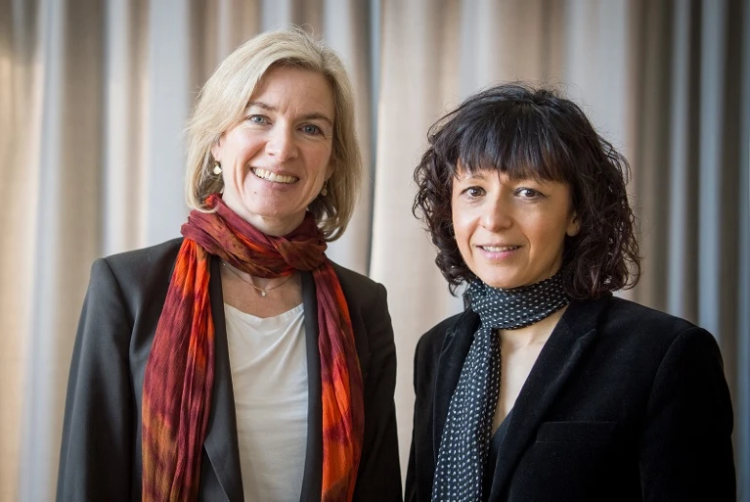
CRISPR-Cas discovery
2022 Noble Prize for Chemistry was awarded to Emmanuelle Charpentier and Jennifer Doudna for “the development of a method for genome editing”

Slide 22
CRISPR-Cas technology
A microbial immune system against virus
Clustered regularly interspaced short palindromic repeats
Genomic sequences microbes used to defend themselves against viral attacks
CRISPR associated (Cas) proteins
Enzymes that cut DNA in specific places, like moleculr scissors

Slide 23
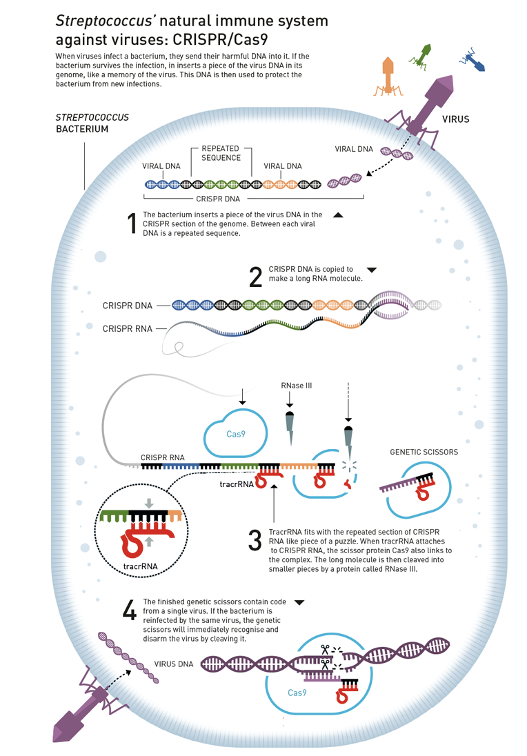
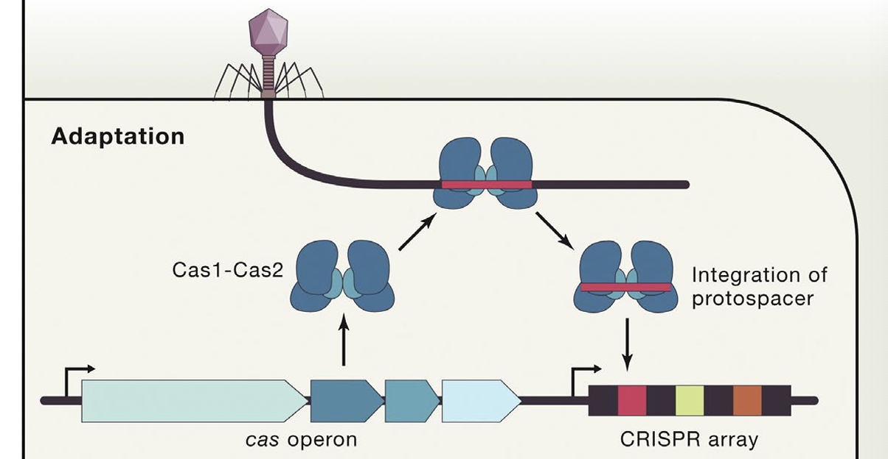
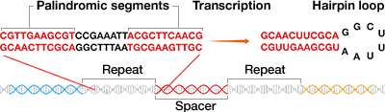
CRISPR-Cas as a microbial adaptive immunity
Adaptation
Maturation
Maturation
Interference

Slide 24
CRISPR-Cas as a genome editing tool
Modified CRISPR-Cas system
1. Cas9 enzyme
2. Single guide RNA (sgRNA)
guide region (crRNA), a 20-nt region complementary to the target sequence
scaffold regions (tracrRNA), multi-hairpin loop sequence binds to Cas9
3. Protospacer adjacent motif (PAM), Cas9 reconition sequence
Direct target-specific cutting of double-stranded DNA
Once dsDNA is broken, DNA repair mechanisms take over to fix the break

Slide 25
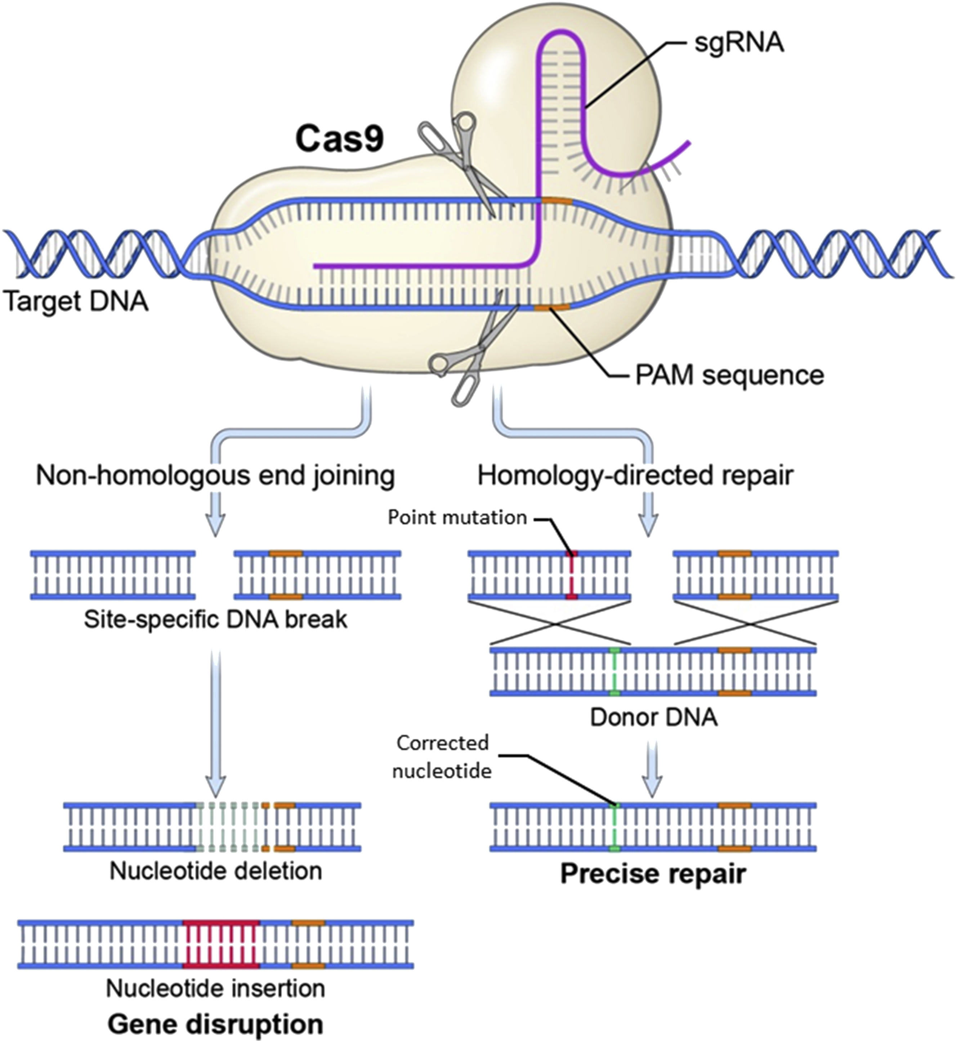
CRISPR-Cas as a genome editing tool
(NHEJ)
(HDR)
(Cuitart, Johnsom & Chien, JID, 2016)

Slide 26
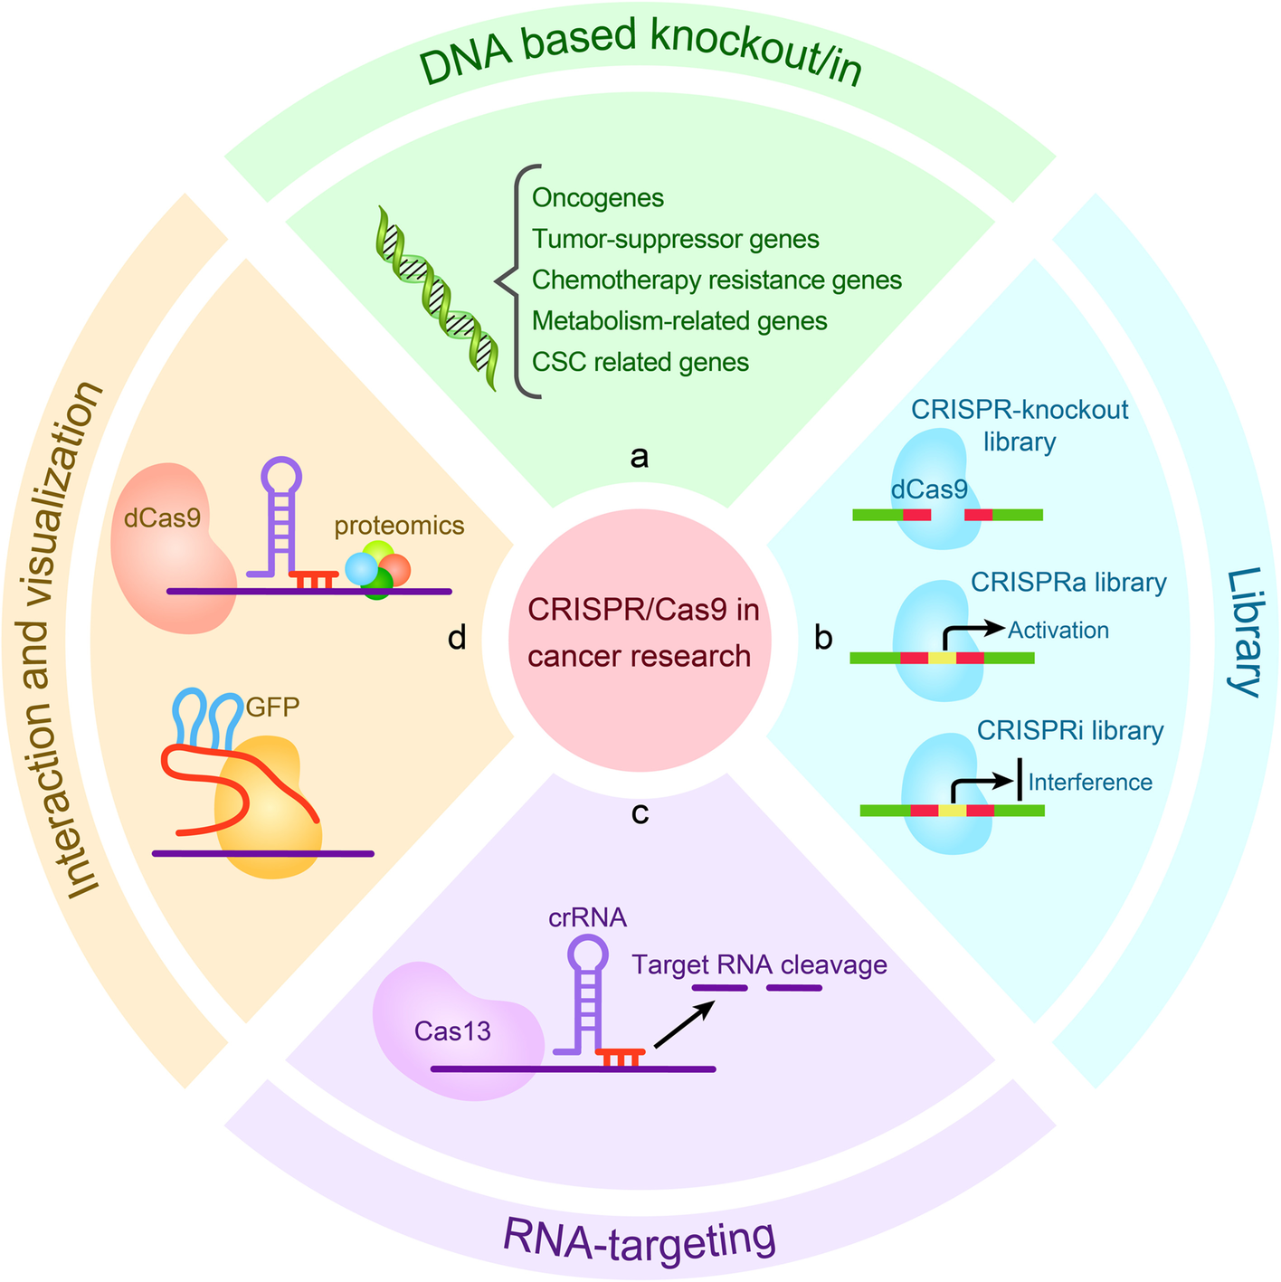
Applications of CRISPR-Cas system
(Zhang et al, Molecular Cancer, 2021)

Slide 27
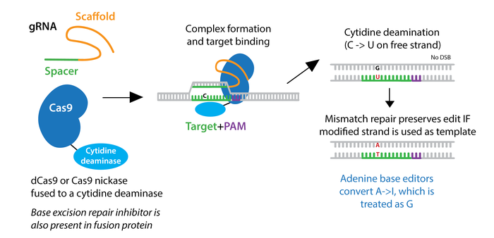
Gene editing
This method displays higher efficiency than HDR-mediated editing.
The first base editors converted cytidine to thymidine; newly engineering base editors convert adenosine to guanosine.

Slide 28
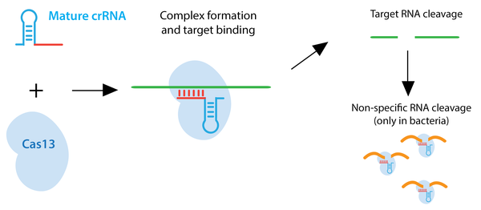
RNA targeting
Cas13 enzymes target RNA rather than DNA, sometimes requiring a protospacer flanking sequence (PFS).
In bacteria, Cas13 targeting also promotes non-specific RNA cleavage, but this non-specific cleavage does not occur in mammalian cells.

Slide 29
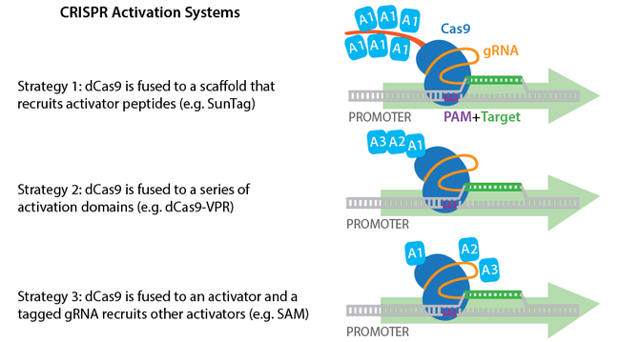
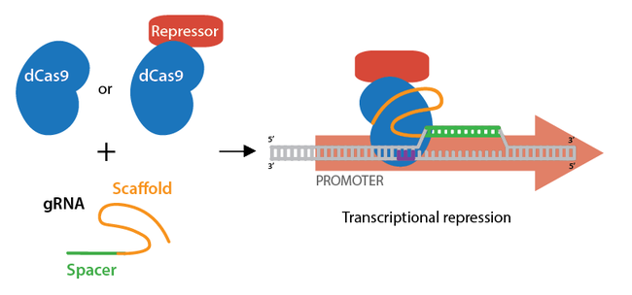
Activation or repression of gene expression
dCas9 fused to transcriptional activators or repressors can modulate transcription in a reversible manner.

Slide 30
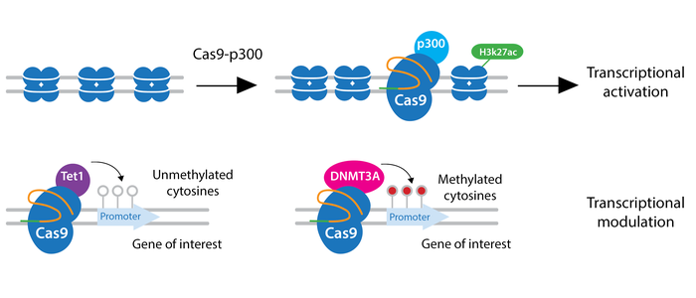
Epigenetics modification
dCas9 fused to epigenetic modifiers can modulate transcriptions and create heritable epigenetic marks.

Slide 31
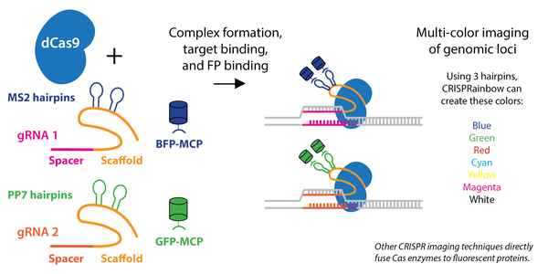
Visualization of target sequences
Fluorescently labeled dCas9 or gRNAs that bind fluorescent proteins can be used to image genomic loci in live cells.

Slide 32
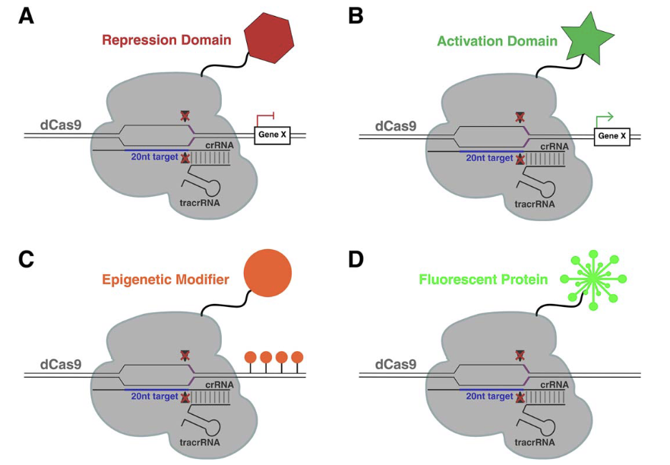
CRISPR-Cas technological advances
Protein tagging
tag endogenous loci with epitope tags or fluorescent markers.

Slide 33
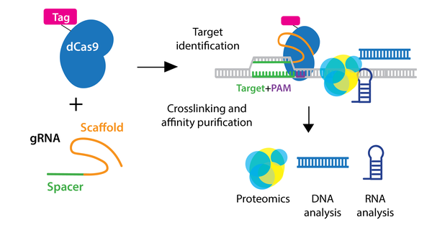
Purification of genomic components
Epitope-tagged dCas9 can also be used to purify a genomic locus and its associated proteins or RNAs through ChIP or biotin-streptavidin pulldown.

Slide 34
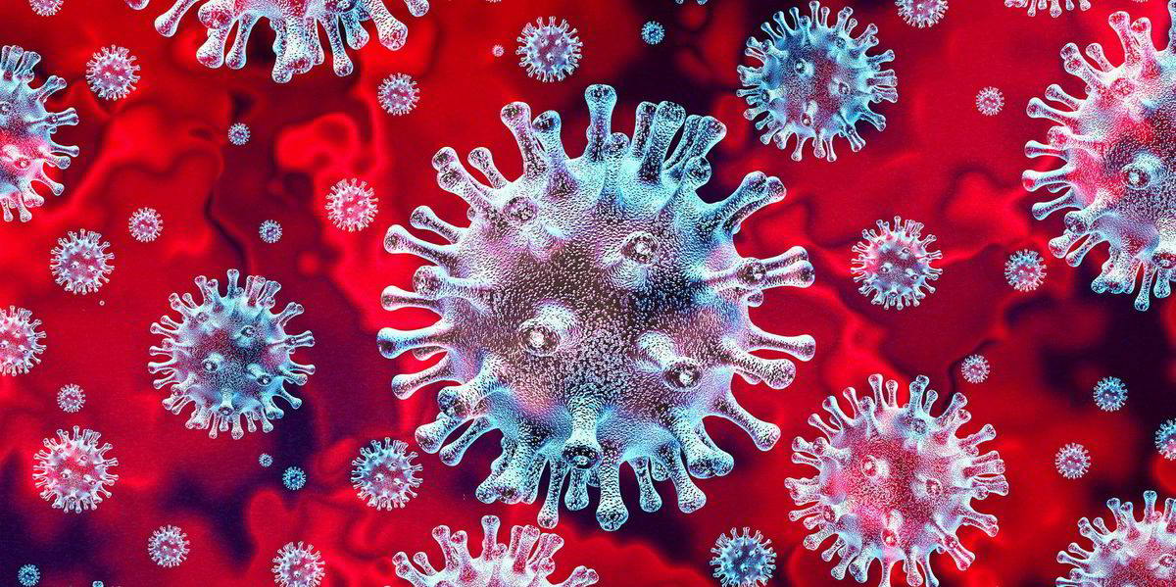
SARS-CoV-2 diagnostic assays

Slide 35
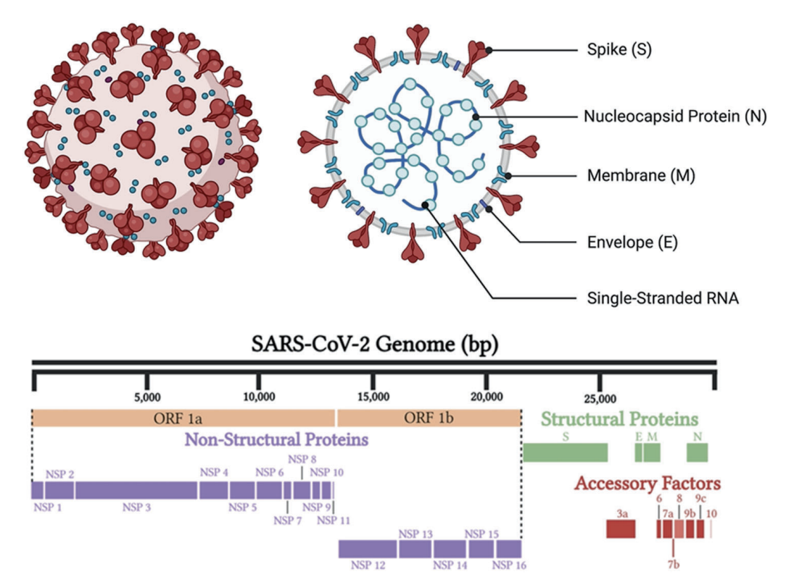
SARS-CoV-2 structure
ssRNA+

Slide 36
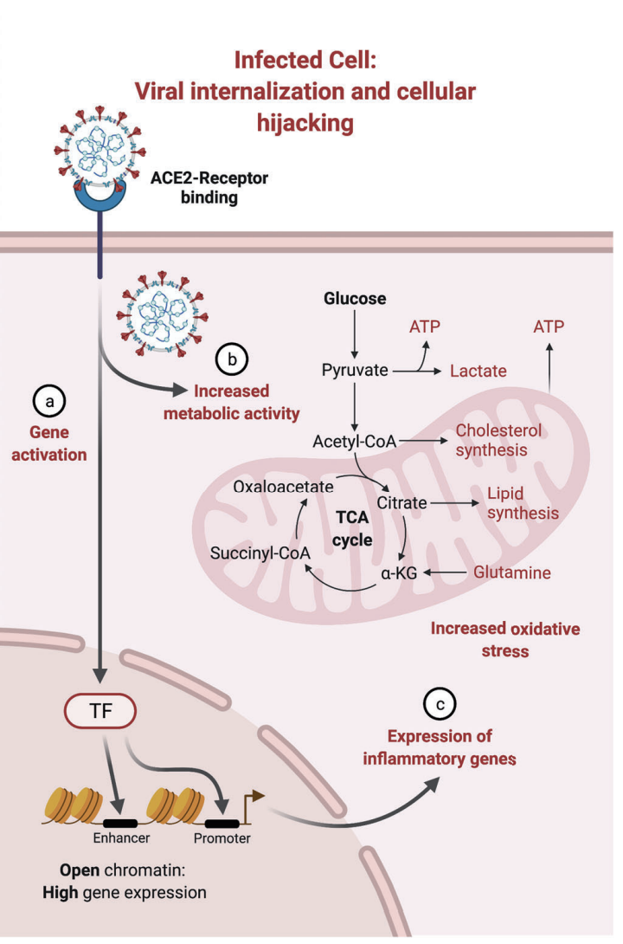
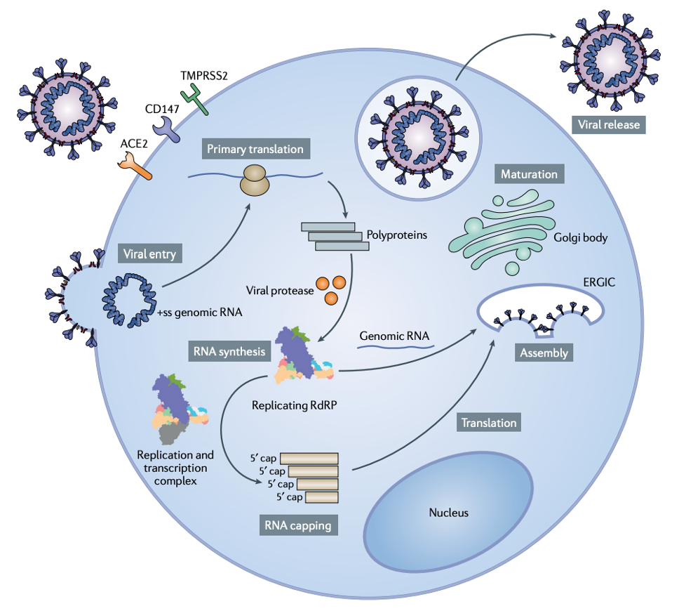
SARS-CoV-2 replication

Slide 37
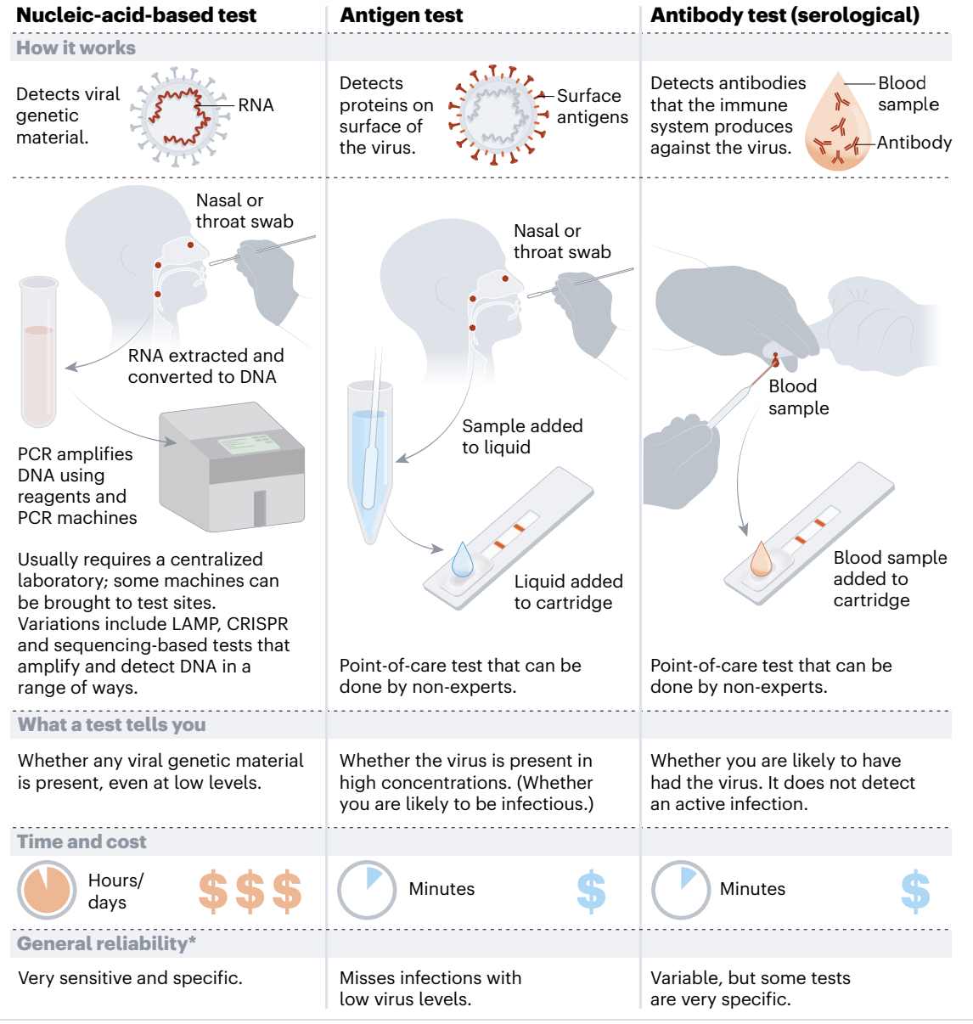
SARS-CoV-2 detection

Slide 38
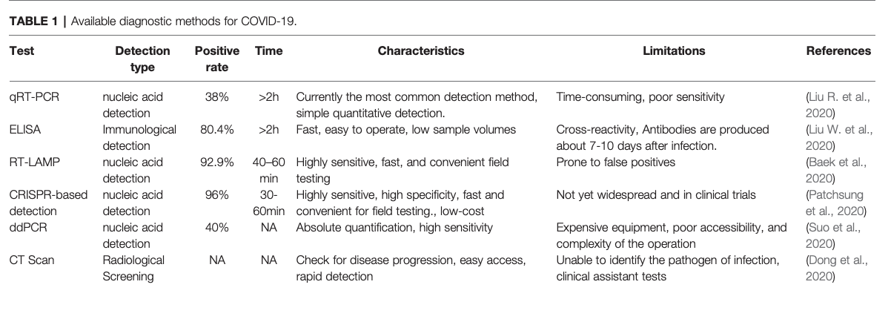
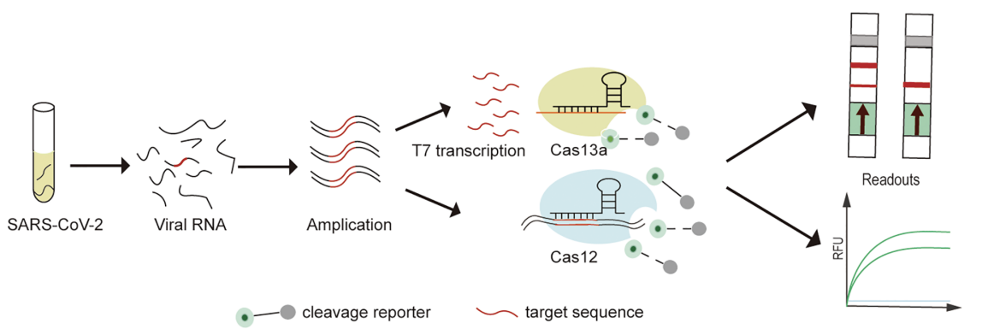
SARS-CoV-2 detection

Slide 39
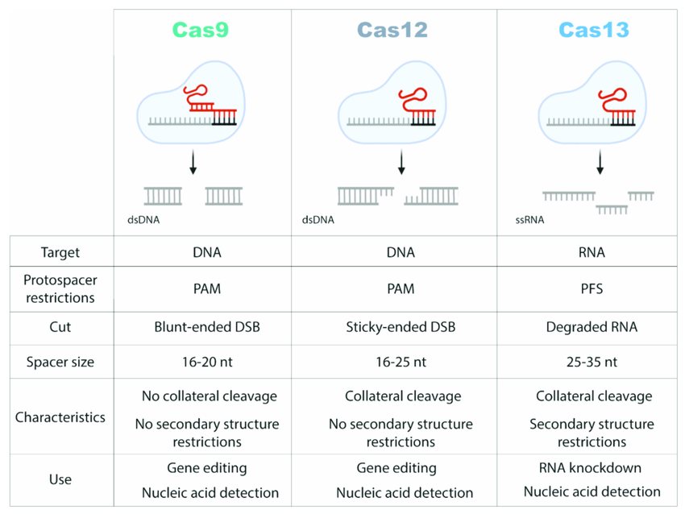
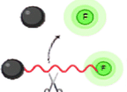
CRISPR-Cas systems
DETECTR
SHERLOCK

Slide 40


CRISPR-Cas-based detection of SARS-CoV-2

Slide 41


CRISPR-Cas-based detection of SARS-CoV-2

Slide 42

CRISPR-Cas diganostic assays

Slide 43

CRISPR-Cas diganostic assays

Slide 44

Implementation of diagnostic tests

Slide 45
Thank you. Q&A
patipark.k@chula.ac.th

